Slide 1
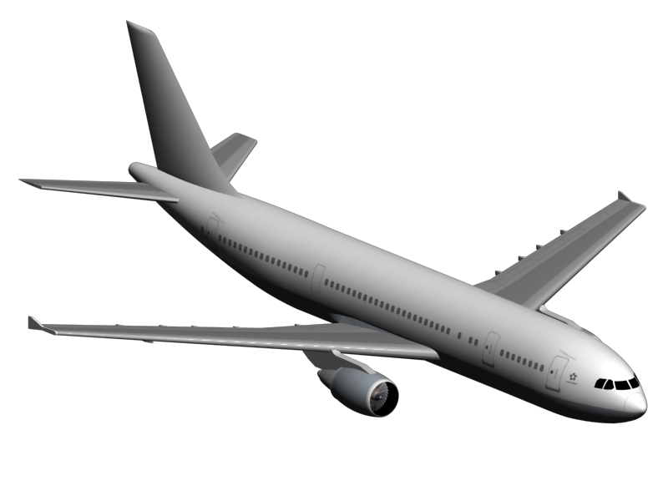
Data Analytics - UTSA
Project 1
Group 4
Impact of COVID-19 on Flight Activity from January to July 2020

Slide 2
Executive Summary
Situation
The COVID-19 pandemic has adversely affected several industries worldwide. In response to the pandemic, many countries restricted travel which drastically impacted air travel.
We investigate this impact using flight data for US flights from the US Department of Transportation’s Bureau of Transportation Statistics (BTS).
Scope
The data has monthly summaries of passengers with origins and destinations of the flights taken each month and is only current through July 2020.
For this reason, we limited our analysis to compare only January to July in 2019 and 2020.
Business Questions
How has the pandemic impacted the airlines?
How has the pandemic impacted the domestic and international markets?
How has the pandemic impacted travel destination?

Slide 3
Top 10 impacted airlines in the US have lost more than 50% of their passengers
Passengers
Main insight
Main insight
On average, the most affected airlines have suffered a reduction of more than 26 million transported passengers.
Top 10 impacted airlines represents 74% of passengers lost during January – July 2020 vs 2019.

Slide 4
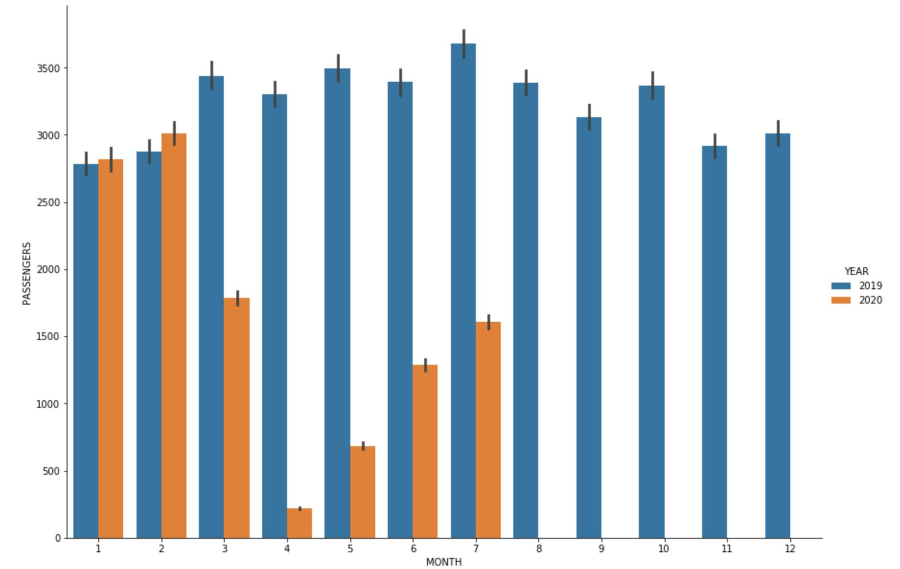
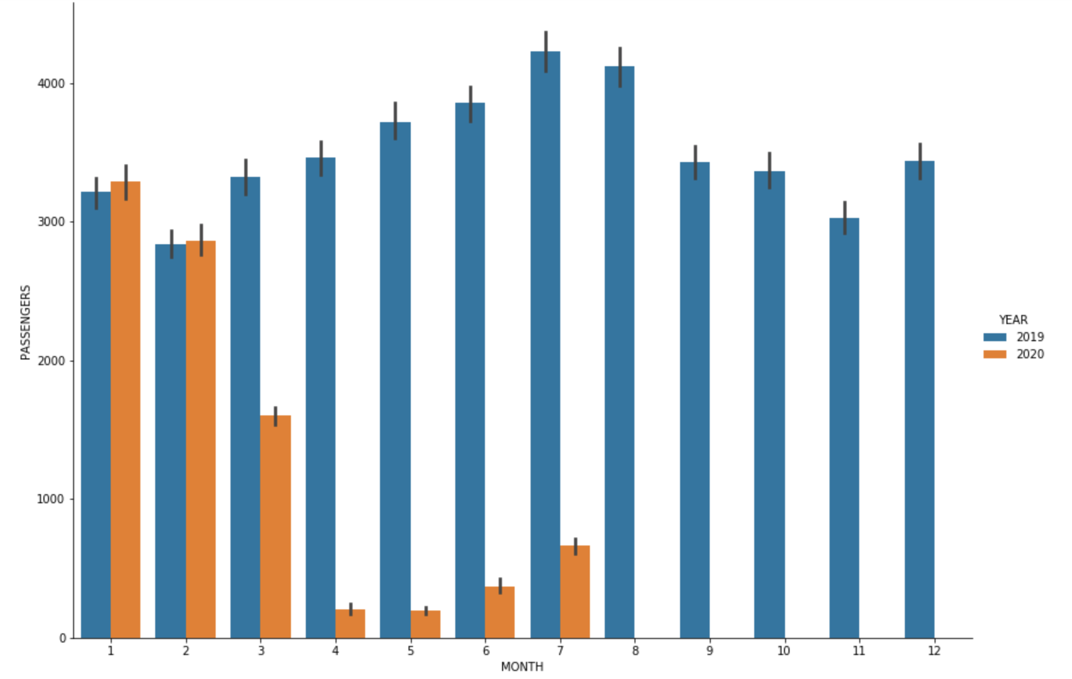
Domestic vs international… describe like a story
Domestic
International
Increase on the rise
Businesses starting to go back to work
Increasing at Slower Rate
Quarantine Policies

Slide 5
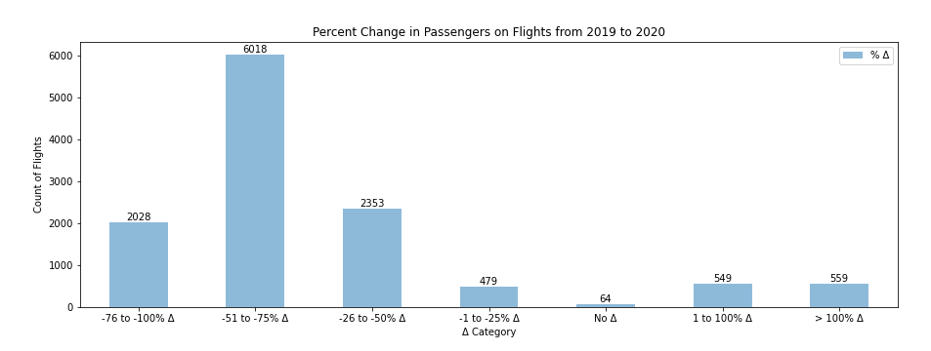
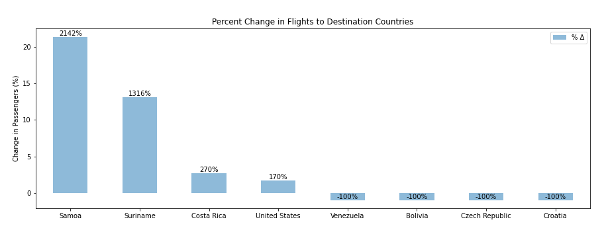
How has the pandemic impacted travel destinations?
Four countries saw an average increase in passengers on flights that was >= 100%
Most flights saw a passenger decrease between 50 and 75%.
Notes:
Looked at flights (origin to destination) to assess change passengers.

Slide 6
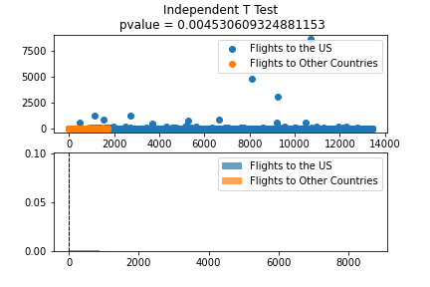
Is there a statistical significance when looking at travel to the US vs travel to other countries?
Null Hypothesis: There is no statistical significance in the percent change of passengers flying to the US and other countries in 2019 and 2020.
Alternative Hypothesis: There is a statistical significance in the percent change of passengers flying to the US and other countries in 2019 and 2020.
Independent T Test
Population 1: flights destined for the US
Population 2: flights destined for other countries
Alternative Hypothesis Confirmed
High Statistical Significance
pvalue = 0.0045

Slide 7
Other Areas to Explore
Analyze and forecast the trend of the airline industry for the future years.
Evaluate the correlation between the reduction of travel and tourism in the most impacted cities.
Evaluate if there is an impact on economy in general on the most impacted cities.
Evaluate if there is an impact on hotel industry.

